Slide 1

Walmart Store Expansion Recommendations
Sales by Size, Type of Store,
and Product Placement
at 45 Supercenters Nationwide

Slide 2
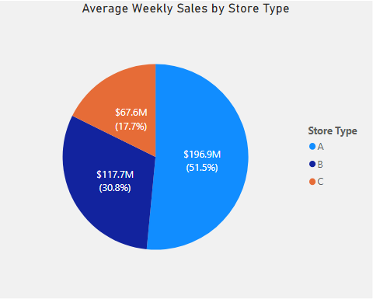
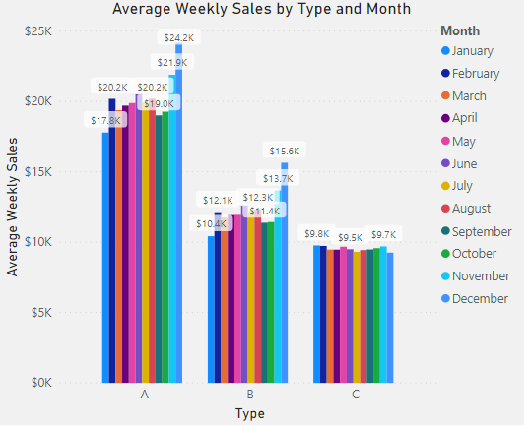
Investing in new Type A supercenter stores with a capacity of 201K and 183K sq. ft. and strategically positioning merchandise from departments with the highest sales will appeal to most of our customers and maximize sales revenue.
Average Sales by Store Type, YTD, $m, $k
Key Insights
Average sales at Type A supercenter stores were:
50% higher than Type B stores.
98% higher than Type C stores.
Source: Walmart Recruiting - Store Sales Forecasting, accessed 11/24/2019 at https://www.kaggle.com/c/walmart-recruiting-store-sales-forecasting/data

Slide 3
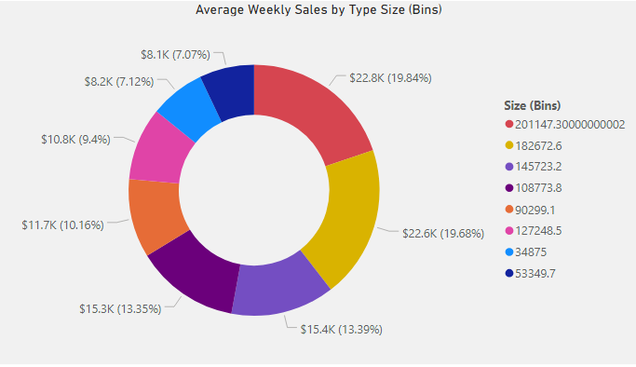
Average weekly sales at supercenter stores with a capacities of 201K sq. ft. ($22.8K) and 183K sq. ft. ($22.6K) together accounted for more than one third of total in-store sales.
Average Weekly Sales by Store Size, $k
Key Insights
Sales at supercenter stores with capacities of 201K and 183K sq. ft. were:
39% higher than stores with capacities of 146K and 109K sq. ft.
66% higher than stores with a capacity of 90K sq. ft.
101% higher than stores with capacities of 53K and 35K sq. ft.
Source: Walmart Recruiting - Store Sales Forecasting, accessed 11/24/2019 at https://www.kaggle.com/c/walmart-recruiting-store-sales-forecasting/data

Slide 4
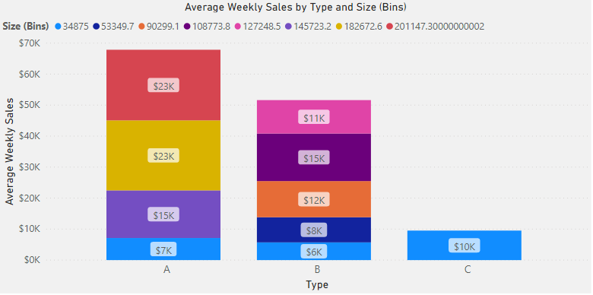
Preference should be given to opening new Type A supercenter stores with a capacity of 201K and 183K sq. ft. These stores had the highest sales average of $23,000/week, representing 39.5% of total in-store sales.
Average Weekly Sales by Store Type and Size, $k
Key Insights
Second highest sales were Type A and Type B stores with a capacity of 146K sq. ft. and 109K sq. ft., respectively, with $15,000 per week.
Third was Type B stores with a capacity of 90K sq. ft. at $12,000 per week.
Source: Walmart Recruiting - Store Sales Forecasting, accessed 11/24/2019 at https://www.kaggle.com/c/walmart-recruiting-store-sales-forecasting/data

Slide 5
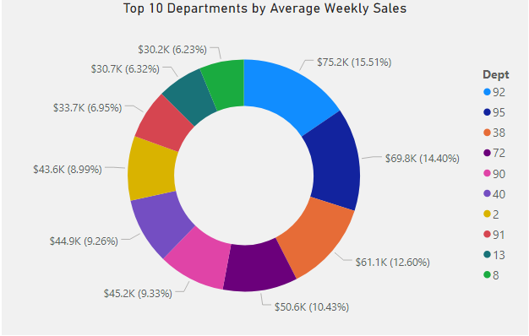
The top 10 departments by average sales account for nearly half (46%) of total in-store sales. To maximize sales at new stores, merchandise from these departments should be positioned in the most heavily-trafficked areas.
Average Weekly Sales by Department, $k
Key Insights
Top 3 departments accounted for 20% of total sales.
Top 5 departments accounted for 29% of total sales.
Top 10 departments accounted for 46% of total sales.
Source: Walmart Recruiting - Store Sales Forecasting, accessed 11/24/2019 at https://www.kaggle.com/c/walmart-recruiting-store-sales-forecasting/data

